Slide 1
Explanation of Diffusion Waves
Power Point # 2
By Michelle Goodman

Slide 2
Summary
Questions:
What is the relationship between beta, the single wave profile and t_{lag} for zero diffusion?
Can we extrapolate this relationship into the region below the bifurcation point? Thus predicting the diffusion case
What is the shape of the Global Wave profile determined by?
Can you determine $β$ from the concentration profile?

Slide 3
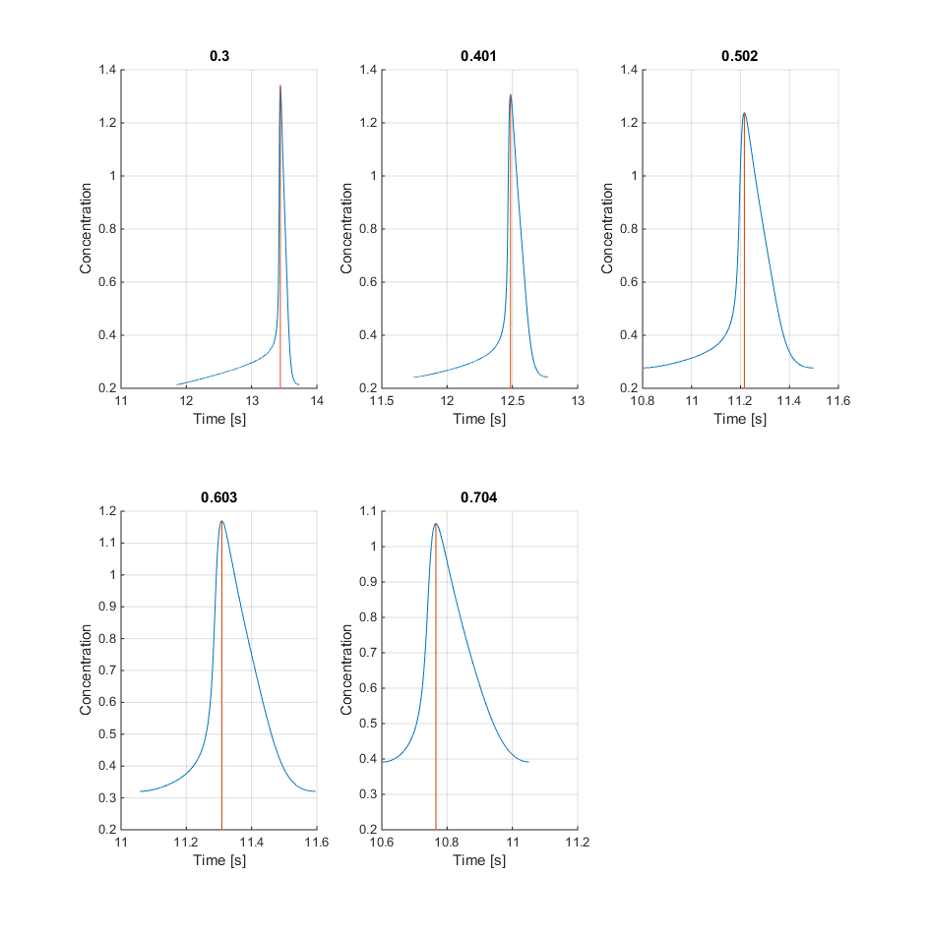
Beta vs Single Wave Profile
What is the relationship between beta, the single wave profile and t_{lag} for zero diffusion?

Slide 4
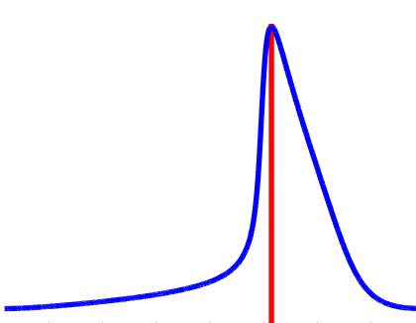
Beta vs Single Wave Profile
What is the relationship between beta, the single wave profile and t_{lag} for zero diffusion?
Maximum
Rate of Fast Increase
Rate of Decrease
Average Rate of Slow Increase
% Location
% Location
% Location

Slide 5
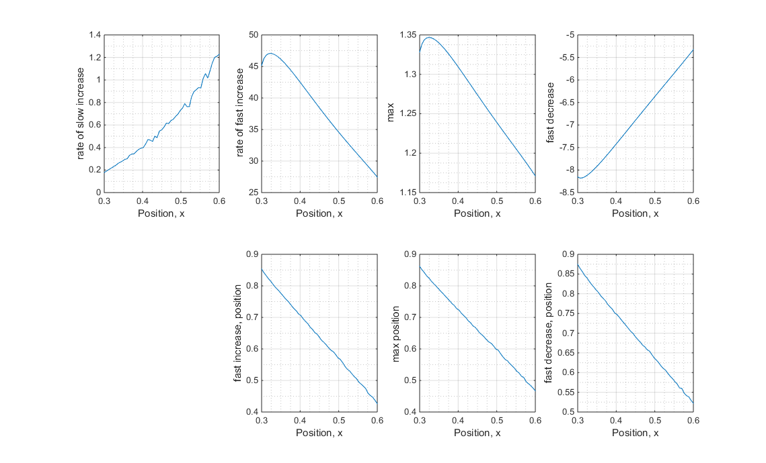
Beta vs Single Wave Profile
What is the relationship between beta, the single wave profile and t_{lag} for zero diffusion?

Slide 6
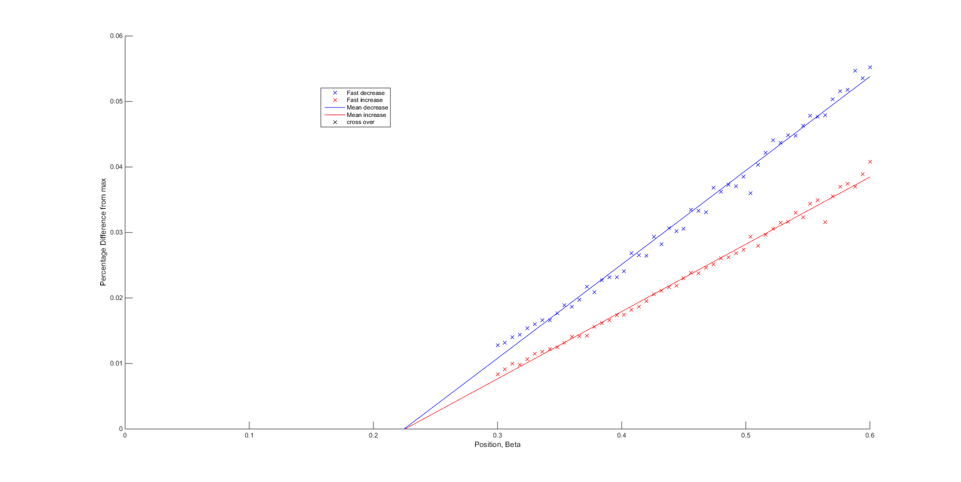
Beta vs Single Wave Profile
What is the relationship between beta, the single wave profile and t_{lag} for zero diffusion?
Is the wave profile tending towards symmetric?

